Slide 1
Effects of Degraded Marshes on Mussel Spat Growth, Recruitment, and Mortality in NYC Estuarine Systems
Antonio Rodriguez
Zarnoch Lab - Baruch College

Slide 2
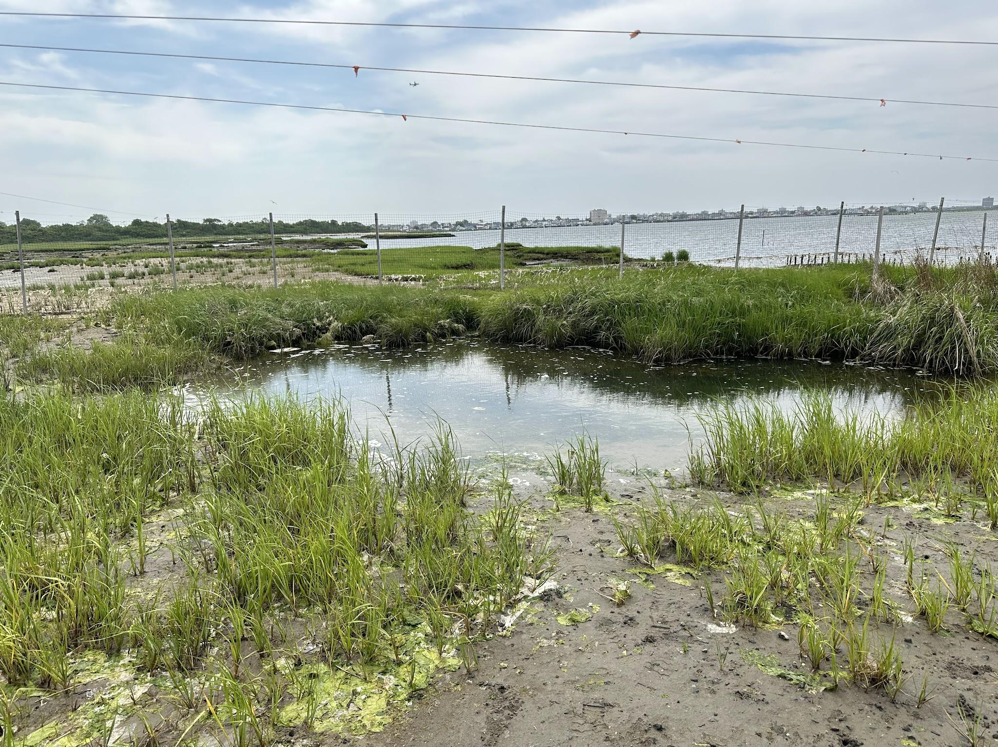
Estuarine Intertidal Marshes
The surrounding marshes of the North-Eastern Coast of the United States offers a multitude of environmental and anthropogenic benefits and services to the surrounding environment.
Protect Coastlines from storm surge and coastal flooding
Promote biodiversity of native species
Sequester Carbon that would go back into atmosphere.
Denitrification, a process that reduces the amount of nitrogenous ions in the water, which can exacerbate stress on aquatic organisms.
These environments experience high variation in productivity and nutrient density dependant upon the season.

Slide 3
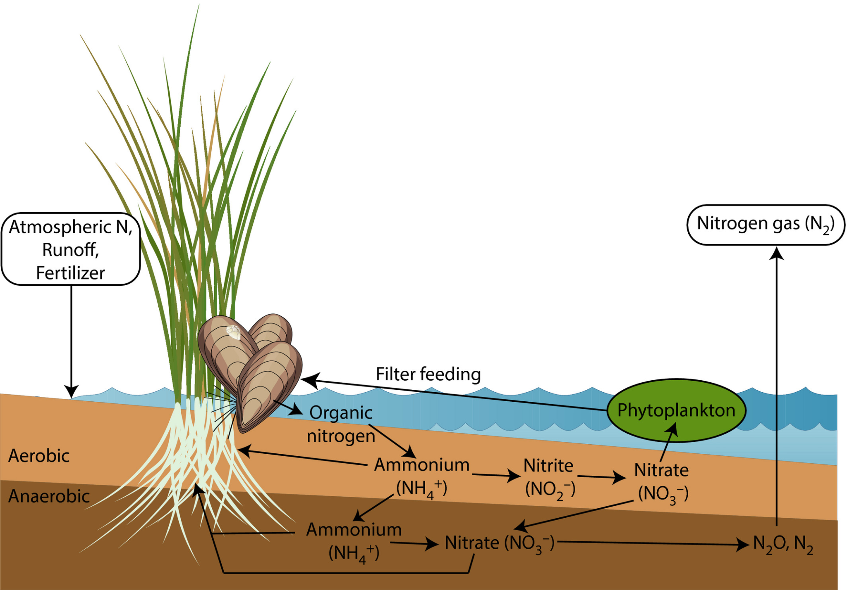
Composition of Intertidal Marshes
Marsh environments are highly dependent upon the mutualism and facultative benefits provided between foundation species.
These relationships, such as that between Smooth Cordgrass and Ribbed Mussels, which predominate the Eastern Atlantic intertidal marsh environments, create biologically aggregating devices that form the foundation of a diverse ecosystem, and subsequent microsystems.
Marsh environments are diverse in a wide array of invertebrates, halophytic plants, small mammals and aquatic avian species.
What is a Foundation Species?
Foundation species are organisms which can occupy any trophic level, that promote and maintain the creation of habitat that is linearly correlated with biodiversity.
The species fitness of such groups act as biomarkers for the health and wellbeing of the overall system.
Bilkovic - Ribbed Mussel and Nitrogen Cycle relationship
Notes:
E.g. - Mass culling of grey wolves across Yellowstone National Park, which in turn caused multitrophic collapse of the ecosystem and subsequent change of physical environment.

Slide 4
Facultative Benefits Between Smooth Cordgrass and Ribbed Mussels
Provide shelter and protection for young larvae and juvenile individuals.
Root system and growth structures exacerbate filtration of larger particles(Abbas, 2022).
creates an environment that varies available light or access points to surface
Provides shelter from predators like blue crabs, marine avifauna, and terrestrial vertebrates.
Feces & pseudofeces promote growth and increase available nutrients of system. (Abbas, 2022).
Strong byssal threads help to stabilize and secure root systems. (Abbas).
Oxygenate soils
Mussel density positively correlated with population density of halophytic plants (Honig et al, 2015).
Notes:
Grass 3.promoting water retention and preventing desiccation.
- Mussels - Pseudofeces - Undigested material that has passed through digestive systems. (Owl Pellets) 2. to decrease chances of displacement from storm surge and excessive flooding or fetch 3. through their feeding mechanism by promoting the movement of water along soil barrier, oxygenating and depositing nutrients through excretion.

Slide 5
Remnant Mussel Bed - Widow Species
The exacerbation of these extenuating factors like : (Abbas, 2022)
climate change
SLR
Sediment Starvation
Nutrient Inundation
Mass placement of impermeable structures
Have expedited erosion and loss of sediments as well as native cordgrass, leaving barren mussel beds, of predominantly degraded marsh sediments, mud, and remnant beds.
Degradation -
The area of Jamaica Bay is being
inundated with excessive anthropogenic nutrients as the four sources of freshwater that predominate the system are wastewater treatment sites(Abbas, 2022).
This area was extremely modified as the industrial growth of the city has exponentially increased,
as well as the construction of JFK International Airport.
Notes:
This new ecosystem lacks the biodiversity of intact marshes. / This dramatic increase in impermeable substrate has caused water retention rates to plummet as well as the submergence of the coastline. amaica Bay is also home to more than 100 species of fish, mollusks, crustaceans, diamondback terrapins, and the critically endangered Kemp’s ridley sea turtle. But below the water’s surface, a lack of oxygen has been choking this aquatic life for decades. The main culprits? Four nearby sewage treatments that were collectively dumping 250 million gallons of partially treated wastewater into the bay every single day.

Slide 6
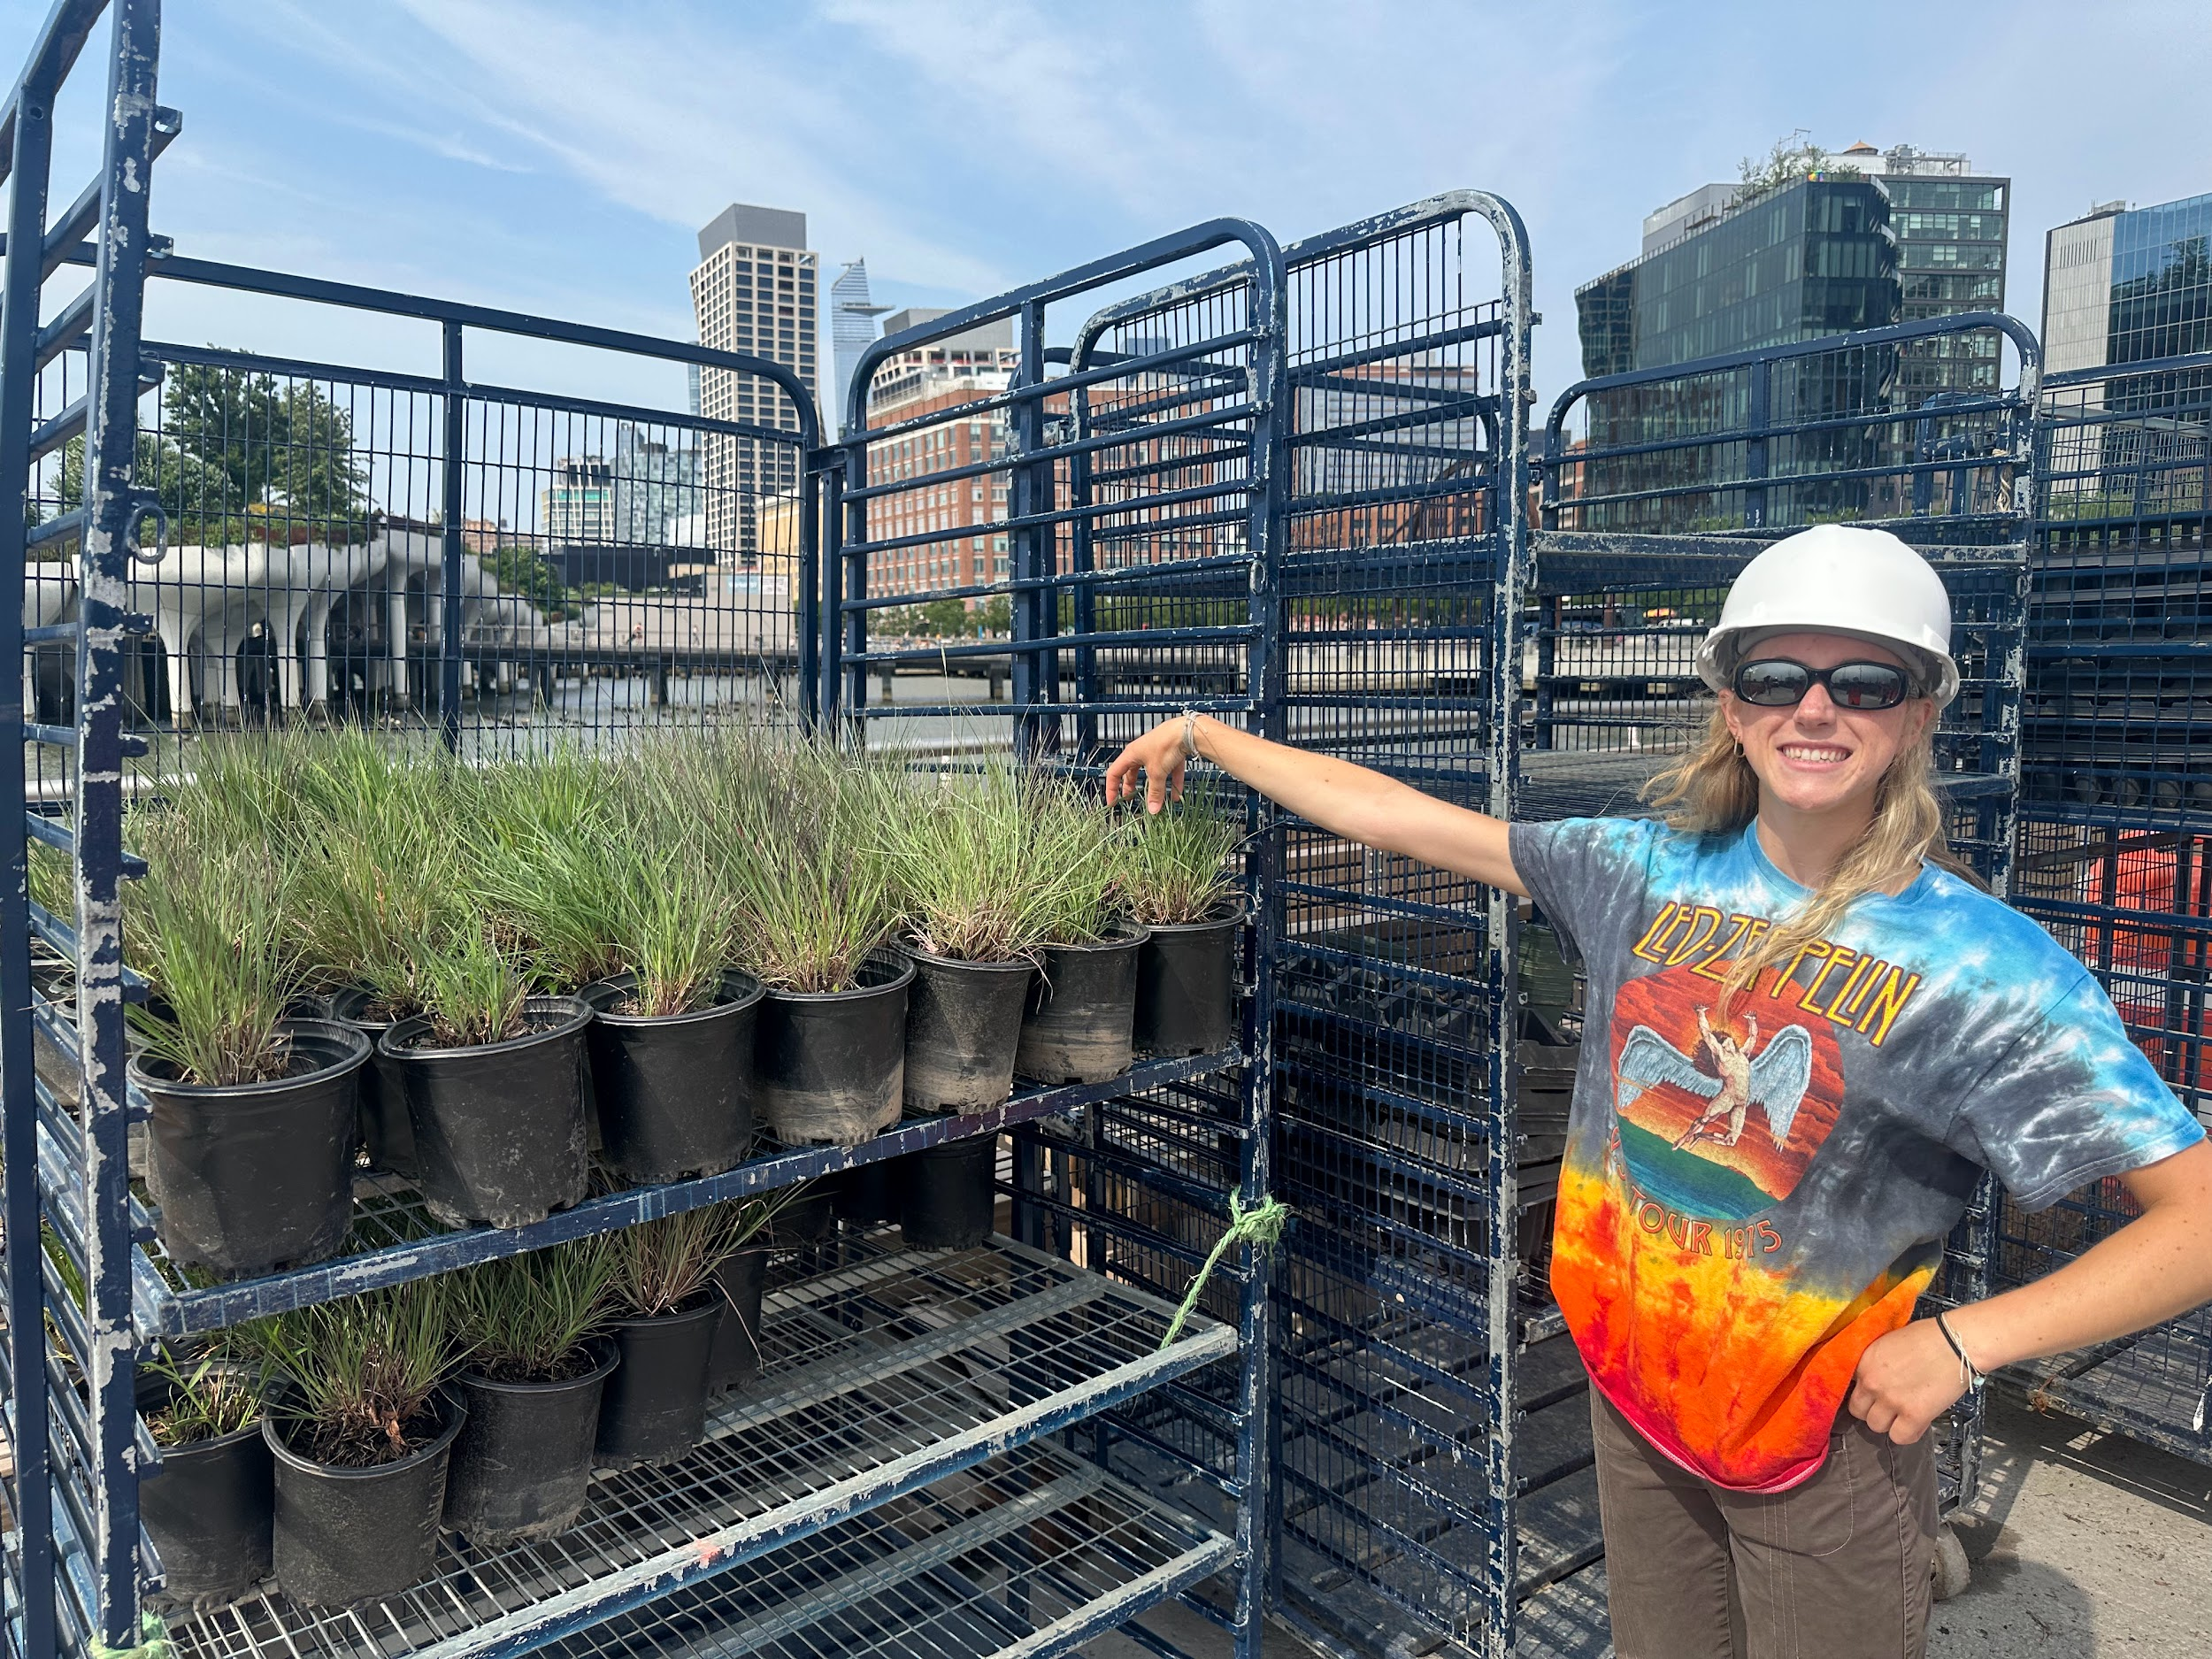
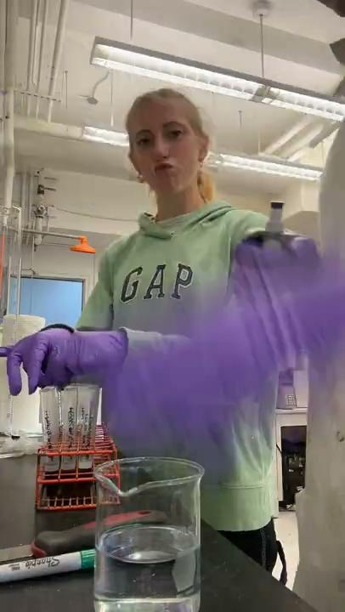
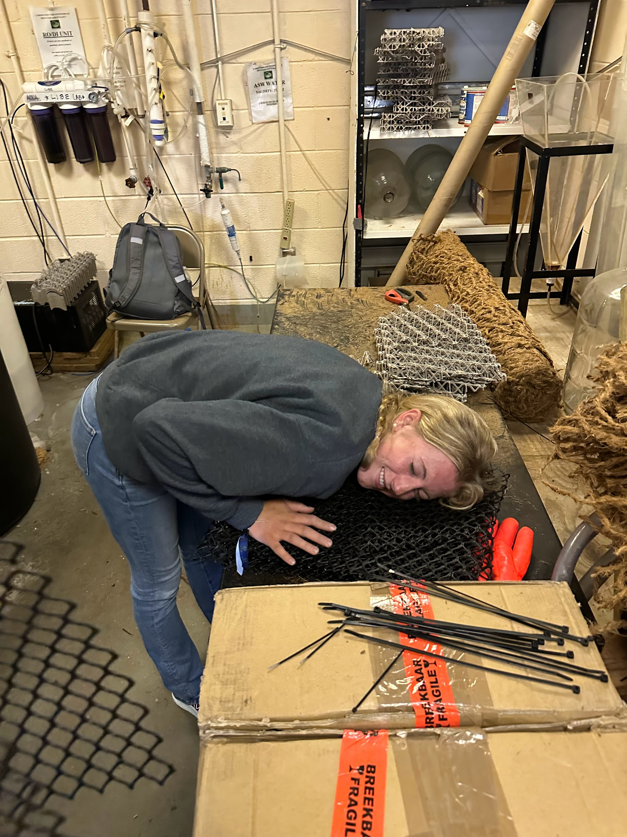
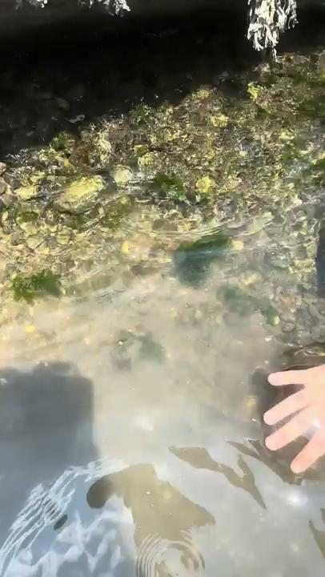
What We’ve Been Doing
Marsh plants used for shoreline restoration at Gavensoort Peninsula.
Shoreline Restoration Project at River Hudson Park
Building mussel spat collectors for Grad Student.
Filtered brackish water coming through ground at Randall’s Island

Slide 7
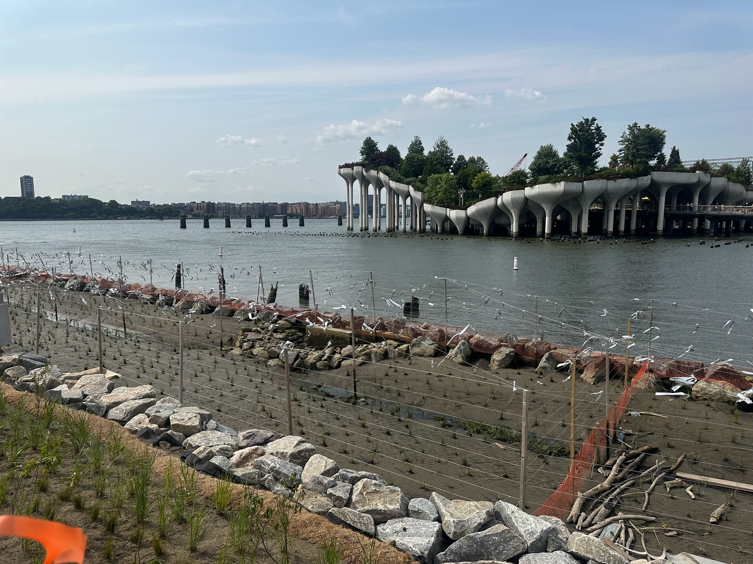
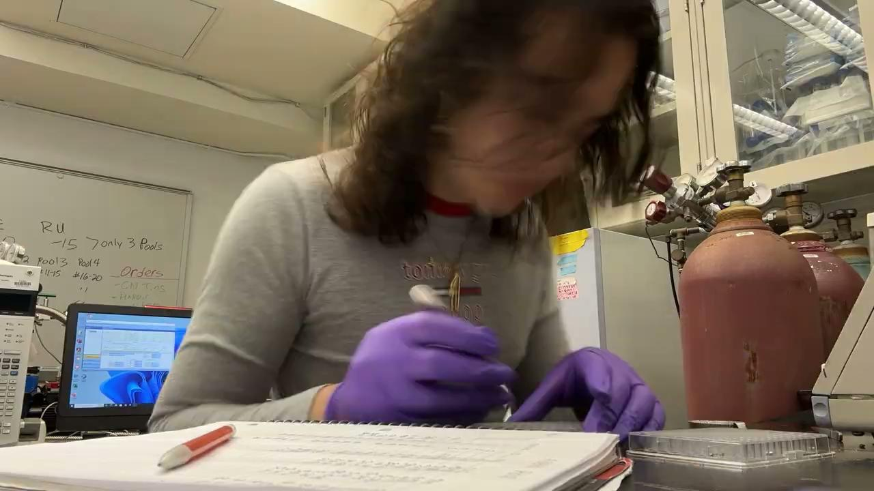
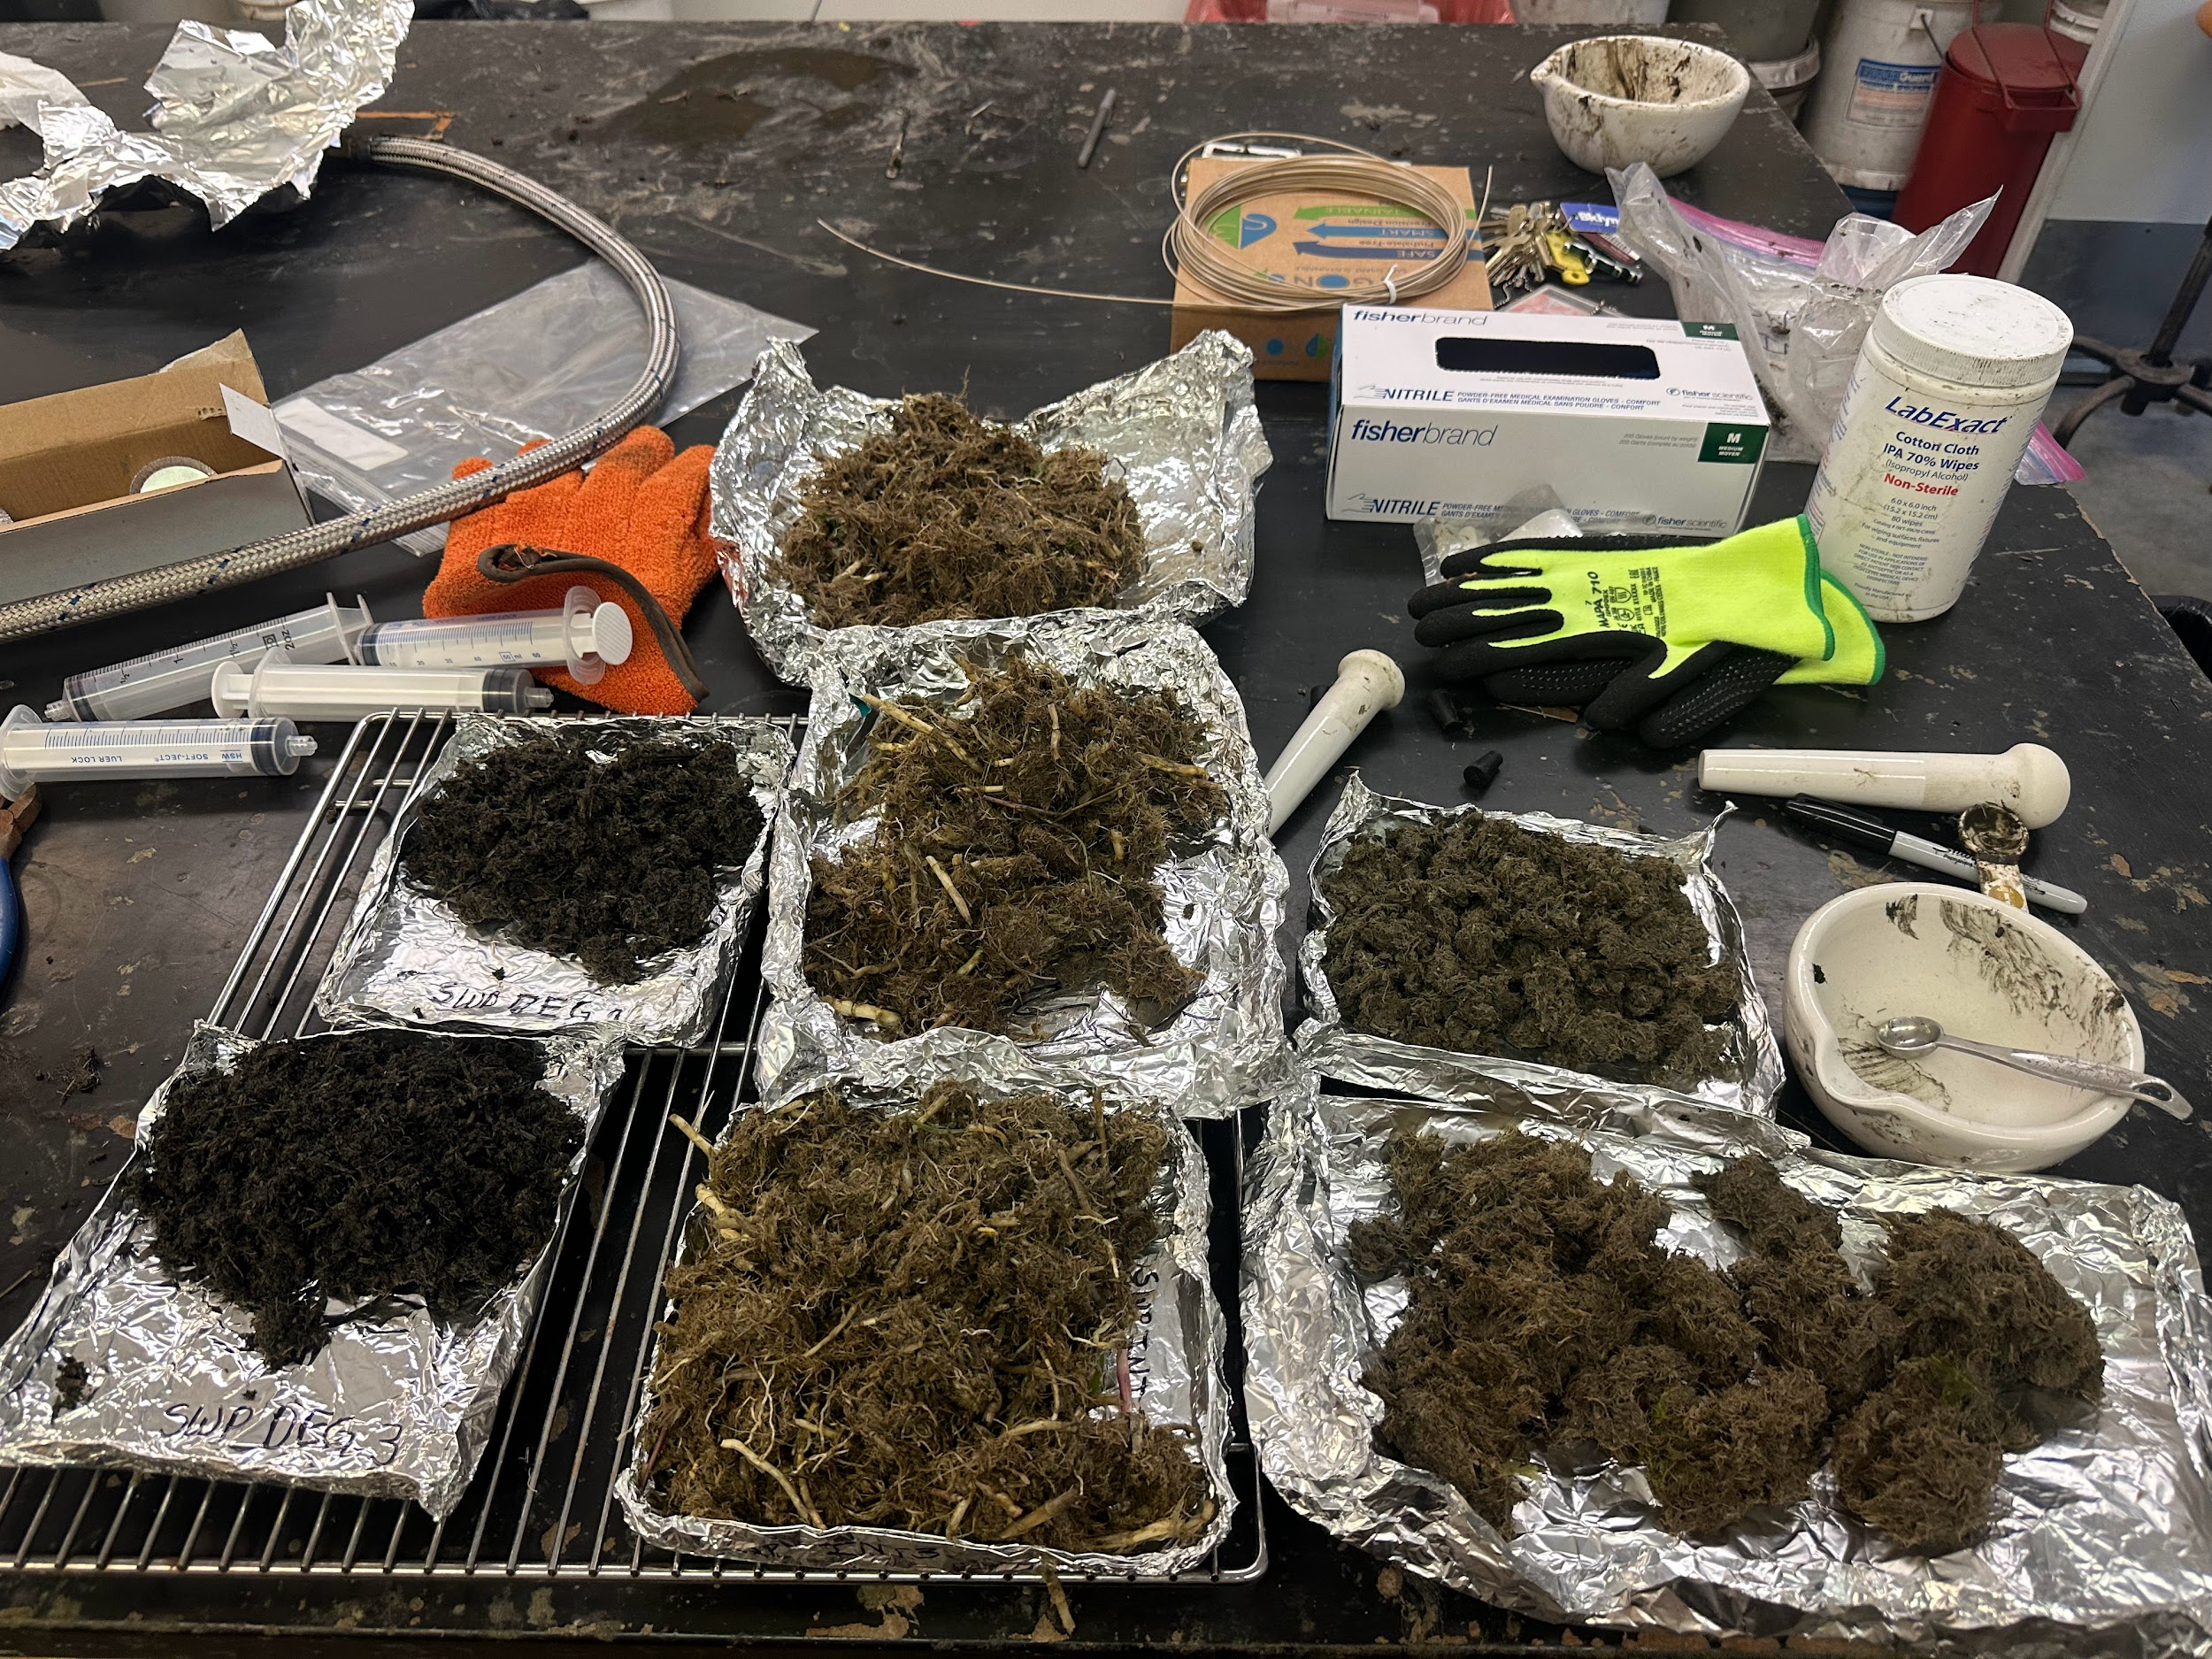
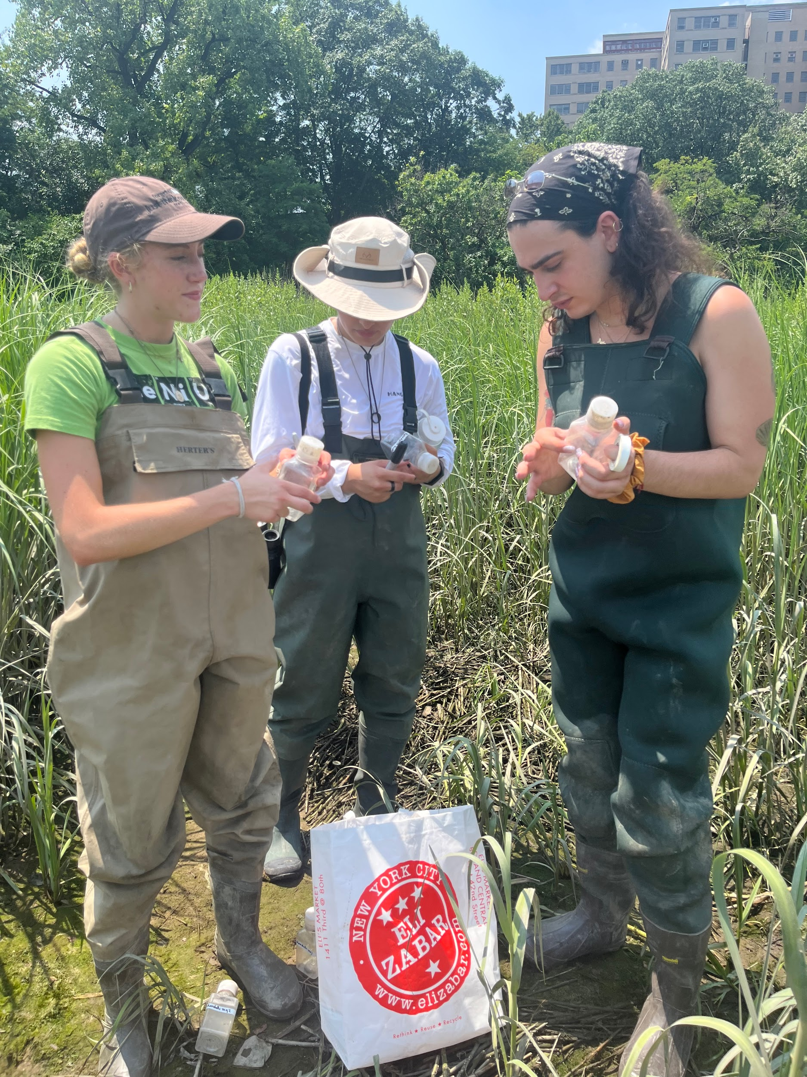
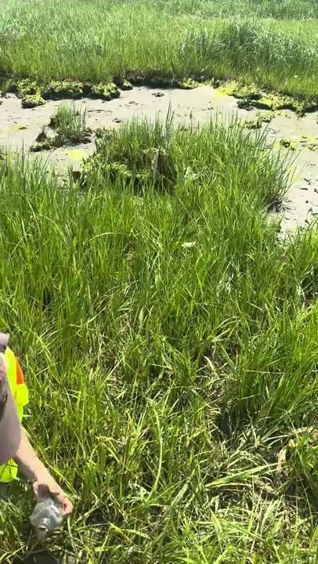
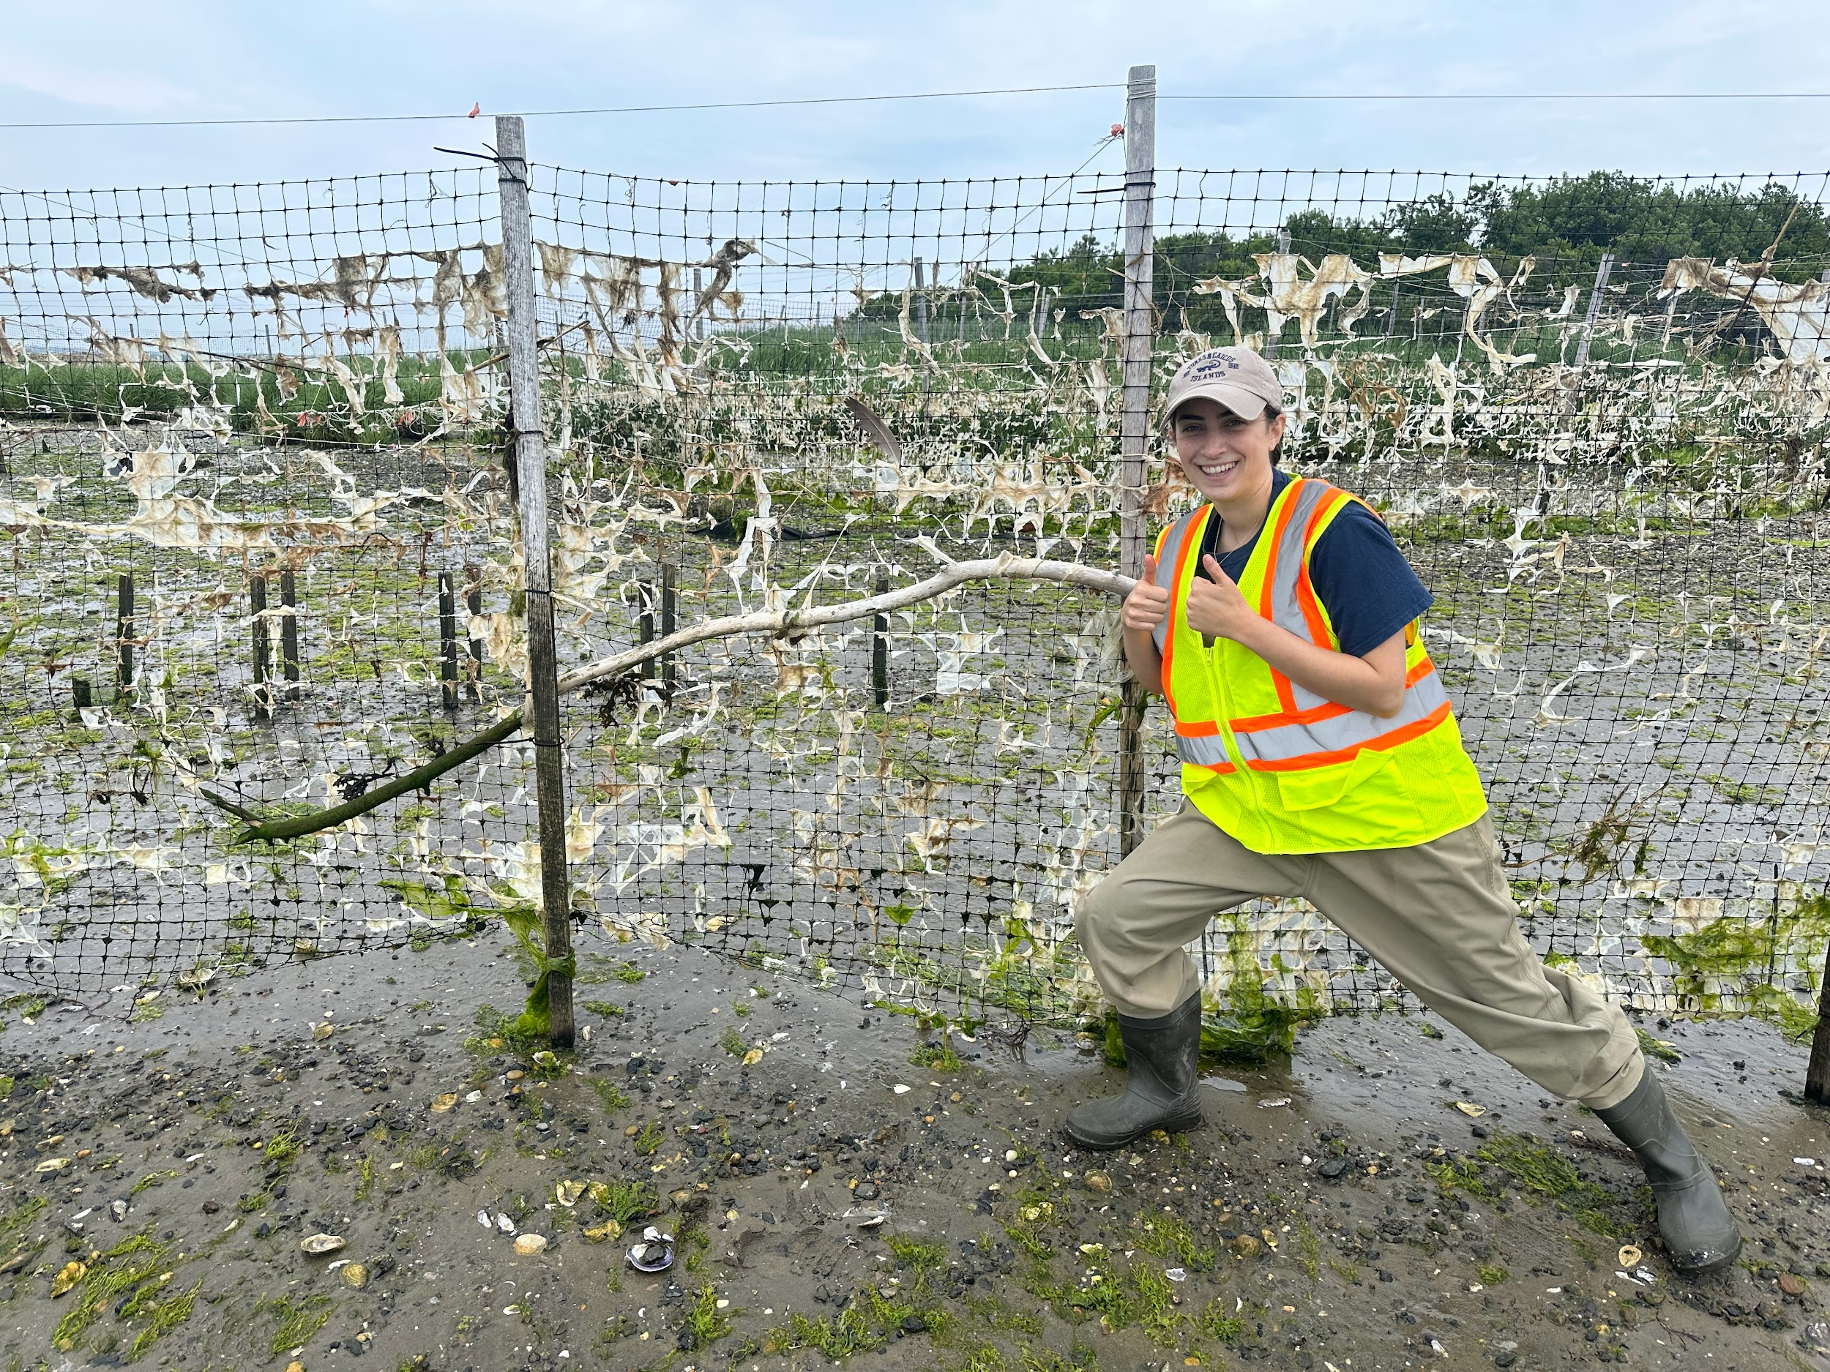
Lab Work & Field Days Cont.
Living Shoreline - Gavensoort Peninsula
Belowground biomass, cleaned, dried and prepped for analysis.
Mass Spec. of Abbas Mussels
Julia pictured with driftwood
Sediment sampling at Randall’s Island Park

Slide 8
Population Ecology of the Gulf Ribbed Mussels across a Salinity Gradient: Recruitment, Growth, and Density - Aaron Honig
B.A.D.’s create physical habitat for species.
Displacement of species can have multi-trophic effects.
Can tolerate a wide variety of environmental stressors, negatively impacts ontogeny
Mussel density greatest at mid salinities
Plant density limited by mussels
Interior mortality affected more by biochemical composition of area than predation, vice versa.
Greater recruitment at marsh edges than internal environments
Notes:
Study done that looked at mussel growth and recruitment in a variety of marsh salinties and placements of marsh 7. Longer periods of tidal inundation

Slide 9
Loss of Salt Marsh Plants Impacts Ribbed Mussel size, density, and influence on sediment nitrogen cycling - Abbas et. al. 2022
Unknown function of remnant beds
Four Wastewater Treatment Sites main freshwater source
Mussels larger in remnant beds
Did not enhance denitrification
Deoxygenated soils
Recruitment decreases
Heterotrophic microbial processes favored
Notes:
Study conducted by Zarnoch’s Grad / sediment cores fluctuations as well as environmental sampling student. 3. Suggests decor. Recruitment 4. Mudflats adj. To remnant beds had higher denitr. Observed

Slide 10
Question(s) & Queries :
Limited variation in size of available particles, reducing survival rate of larval and juvenile ribbed mussels. (Abbas).
Active foraging of juvenile mussels by scavenging predators, loss of attenuation and reduced retention aggravated by an already decreasing recruitment level.
Gulls, raccoons, blue crabs
Remnant beds and loss of above ground biomass decrease protection
Notes:
through their feeding mechanism by promoting the movement of water along soil barrier, oxygenating and depositing nutrients through excretion. 2.

Slide 11
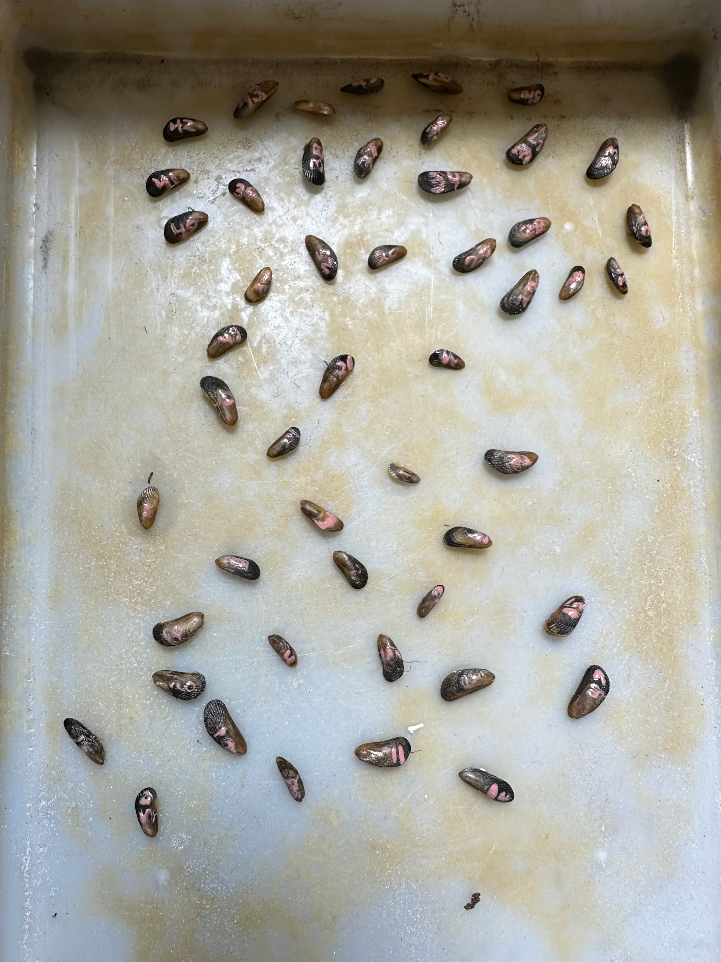
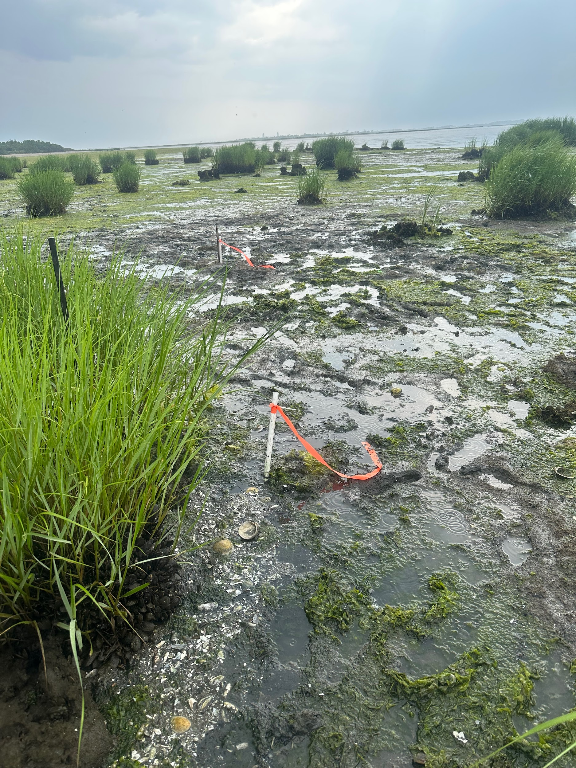
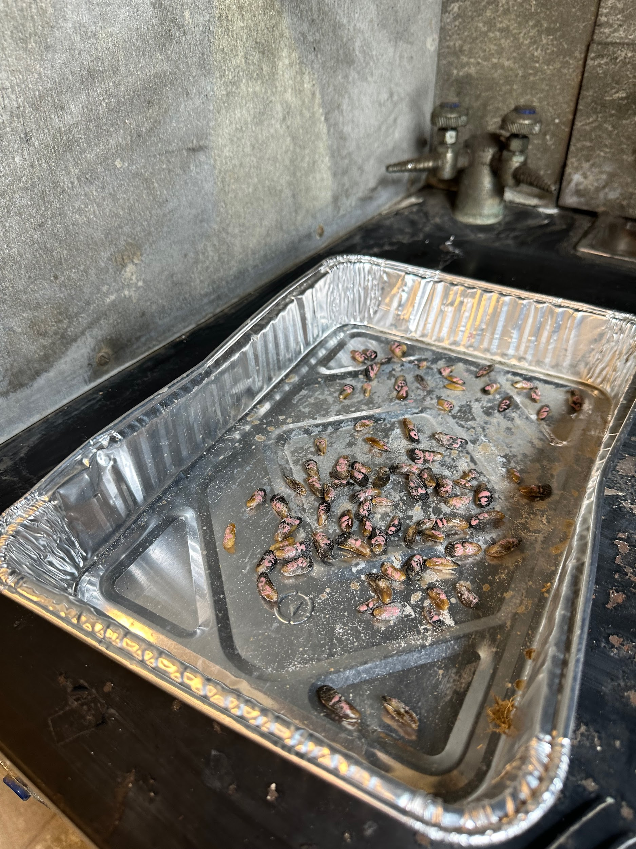
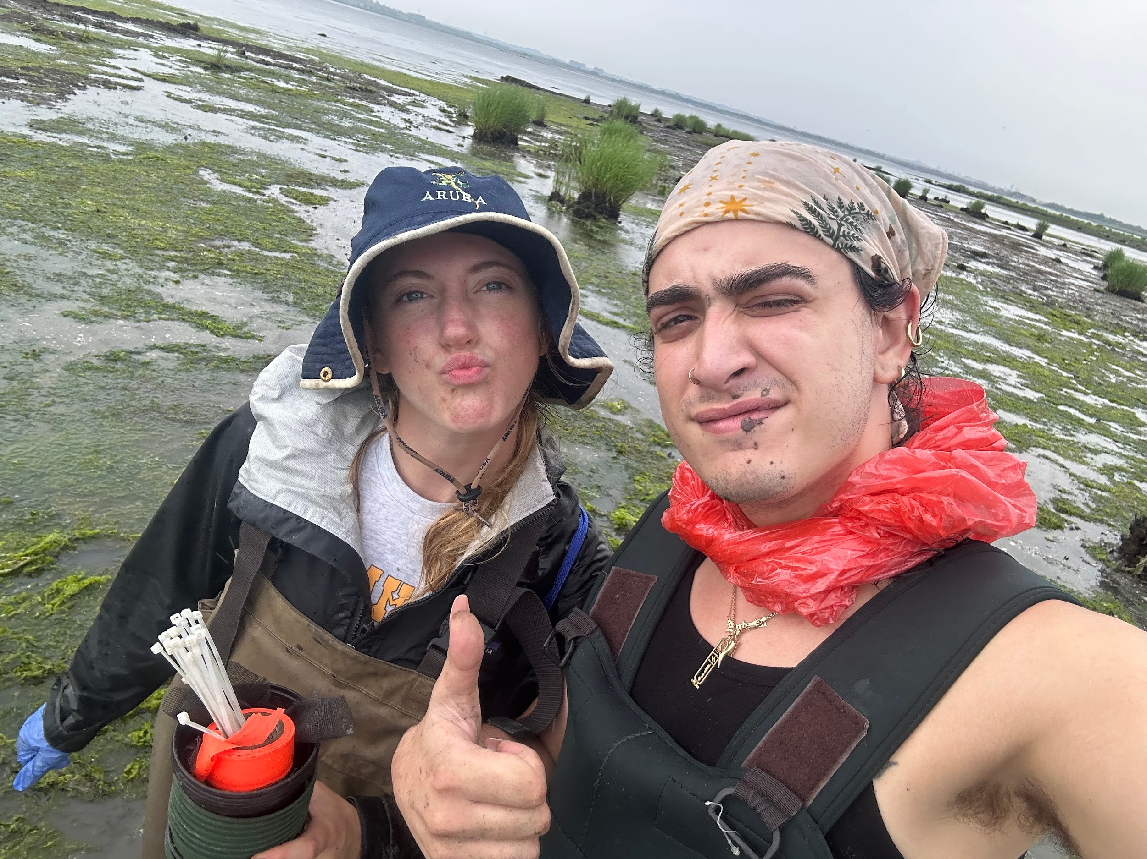
Methods & Experimentation
Collect Juvenile mussels from surrounding NYC estuarine systems.
Label Mussels
Place Spat in variation of treatments
Record growth over period of study
Labeled Mussel Spat
Mussel Spat Collector Along Marsh Edge
Maddie & Antonio - Day of Exp. Launch
Labeled Mussel Spat
Notes:
Measure and separate out mussels less than < 20 mm 2. Measure and label spat with nail polish 3. a. Place 15 larval splat in a planters pot with surrounding sediminent b. Along intact marsh edge and eroded mussel mudflats in areas of similar coastal sea level 4. Recollect and measure growth, mortality, predation, etc.

Slide 12
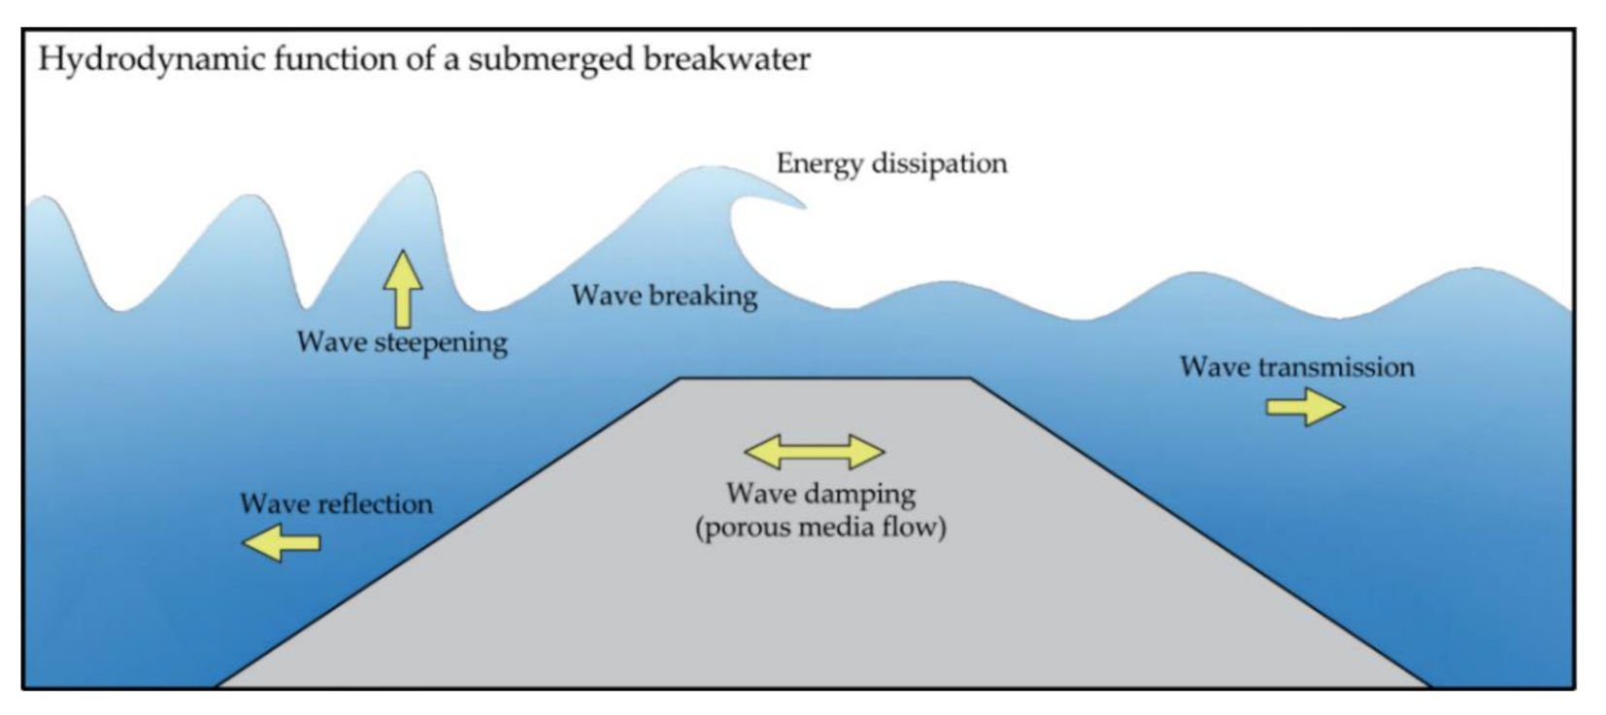
Future Ideas from walking Around the Marsh
During the first two weeks of the BUEE program, I noticed shoreline breakwaters comprised of native oyster shells.
One breakwater of the row of had completely eroded.
Area parallel to coast of specific breakwater open water
Offshore, submerged breakwater comprised of same material, along with a cementation
Biological Aggregating Device of native species, promote biodiversity
Defract wave energy, prevent erosion
( Cardenas, Rojas, Function of a Submeged Breakwater)
Notes:
Offshore breakwaters encourage sedimentation posterior to structure, which could theoretically lower sediment starvation. (Roman Concrete, scientist at MIT, cracked hot mixing process, can cause explosions.)

Slide 13
Citations :
Bilkovic, D. M., Mitchell, M. M., Isdell, R. E., Schliep, M., & Smyth, A. R. (2017). Mutualism between ribbed mussels and cordgrass enhances salt marsh nitrogen removal. Ecosphere, 8(4), e01795. https://doi.org/10.1002/ecs2.1795
Cardenas-Rojas, D., Mendoza, E., Escudero, M., & Verduzco-Zapata, M. (2021). Assessment of the Performance of an Artificial Reef Made of Modular Elements through Small Scale Experiments. Journal of Marine Science and Engineering, 9(2), 130. https://doi.org/10.3390/jmse9020130
Honig, A., Supan, J., & La, M. K. (2015). Population ecology of the gulf ribbed mussel across a salinity gradient: recruitment, growth and density. Ecosphere, 6(11), art226–art226. https://doi.org/10.1890/es14-00499.1
Zhu, J., Zarnoch, C., Gosnell, J., Alldred, M., & Hoellein, T. (2019). Ribbed mussels (Geukensia demissa) enhance nitrogen-removal services but not plant growth in restored eutrophic salt marshes. Marine Ecology Progress Series. https://doi.org/10.3354/meps13132

