Slide 1
What Factors Promote Social Use of the Shoreline?
KC

Slide 2
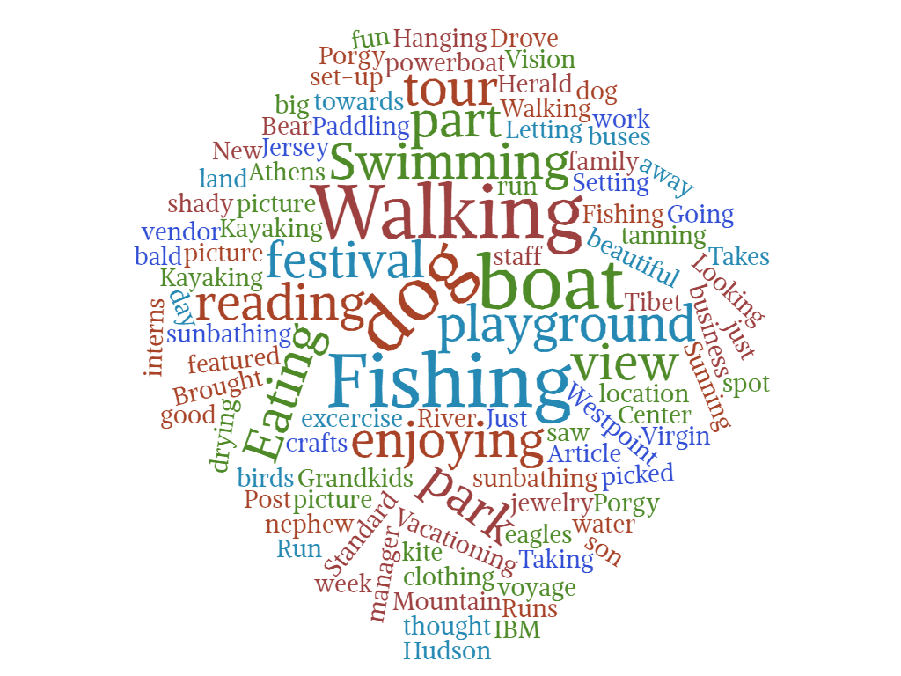
What are you doing at this site today?
Walking:6
Dog:7
Fishing:7
Boat:6
32 responses

Slide 3
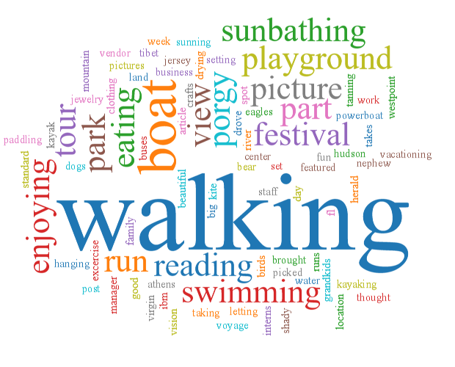
This word cloud shows us that most people visit the shoreline to take a walk and enjoy leisure activities, which is to be expected.
Notes:
http://www.wordtagcloud.com/

Slide 4
Why do you choose to come here?
People say they live near the park but they live over 20 blocks away.
In the city, more people are in the park because its close to where they work and they are on break. 6/10

Slide 5
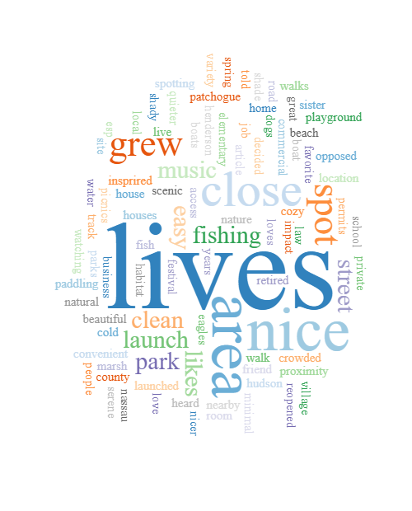
It can be observed that majority of interviewees come to the park because they live near by. An important factor appears to also be aesthetics to a degree with statements such as “beautiful spot” and “nice and clean” being made.

Slide 6
Shoreline impact on feature
Daily
6 total
2: >20
2:11-20
2: 6-10
1: <5
Rarely
1: >20
Occasionally
1:6-10
Rarely | 9 total | 8 >20 block | 1: 6-10
Occasionally | 3 total | 3: >20 blocks
Weekly | 9 total | 6: > 20 blocks | 1: 11-20 1:6-10
Daily | 10 total | 5: >20 | 4: <5 1:6-10

Slide 8
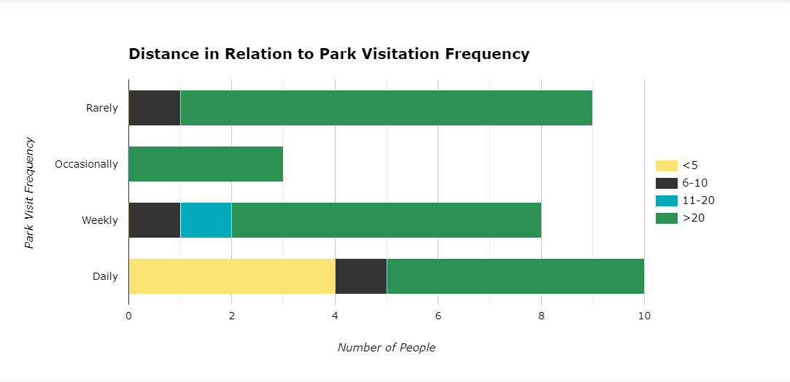
Based on results from the word cloud, it was hypothesized that most people lived nearby the shoreline as
15 responses stated that they were near the park but the data when put together shows that majority of people are over 20 block away.

Slide 9
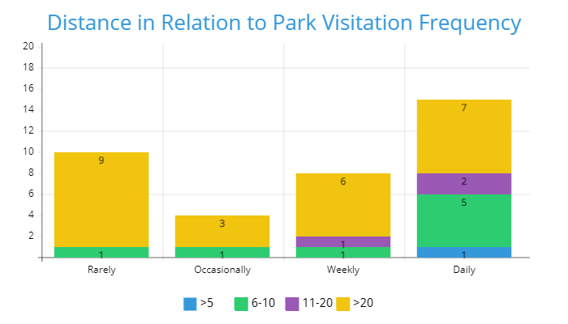
Nyc park

Slide 10
Poster details
3x4 ft poster
Heres a roadmap to answer this data moving forward
*preliminary* results
If distance isnt a factor, the most local locals arent really the biggest visitors.
Observations from this preliminary data
Use quotes to show “WHY” data. Explain the patterns. Push for deeper analysis later on.
Methods: explain the interview.

Slide 11
Businesses, “did you visit any businesses?”
42 total responses
24 no
18 yes
56.25% of people went to visit local businesses, 11 people went to food places.
4 non-food

Slide 12
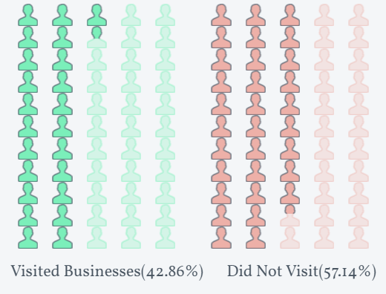
Majority of people visiting the site did not visit the surrounding businesses. The roughly 43% of people who did visit a business, went to places that provided food.
Notes:
Out of the 10 nyc responses, 0 visited local businesses. Most people who did, went to places that had food others went to get gas or bait

Slide 13
9 locations
Separate the distance by region. Use a bar graph
Hsf vs nbf
What do people think of different shoreline
Social coast conference does qualitative research
Parks and us forest service created this survey to better understand
Combine quantitative and qualitative data.
Say something about what matters to people in a shoreline.
Is anyone thinking about shoreline protection.

Slide 14
Purpose:
This qualitative study was conducted in order to understand which social factors most influence people's decision to come to the shoreline. The aim is to understand what influences people to visit these shorelines as well as understand how the framework used to gather this data could be improved.

